Slide 1
Data Structure and Algorithms
(CS212)
Instructor : Syed Musharaf Ali
ROOM G-104-DSE IIUI
Ph# 051-9019724 Ext-2724
Email: musharaf.ali@iiu.edu.pk

Slide 2
Graph
Graph is a non linear data structure, it contains a set of points known as nodes (or vertices) and set of links known as edges (or Arcs) which connects the vertices.
Graph is a collection of nodes and edges which connects nodes in the graph
Generally, a graph G is represented as G = ( V , E ), where V is set of vertices and E is set of edges.

Slide 3
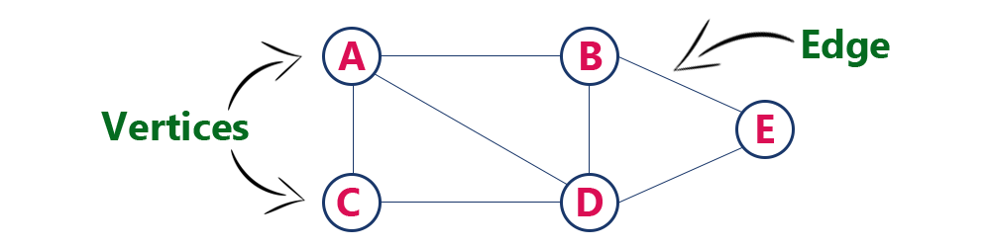
Graph
Example
The following is a graph with 5 vertices and 6 edges.
This graph G can be defined as G = ( V , E )
Where V = {A,B,C,D,E} and E = {(A,B),(A,C)(A,D),(B,D),(C,D),(B,E),(E,D)}.

Slide 4
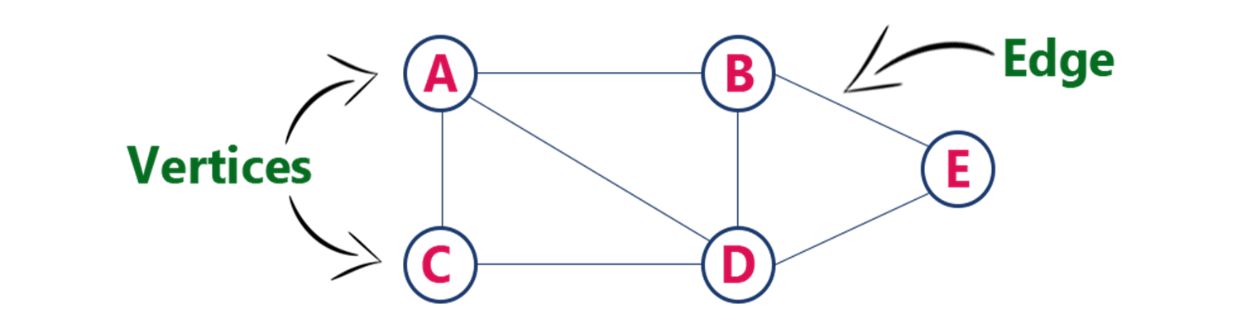
Graph Terminology
Vertex (node)
A individual data element of a graph is called as Vertex. Vertex is also known as node. In given graph, A, B, C, D & E are known as vertices.

Slide 5
Graph Terminology
Edge
An edge is a connecting link between two vertices. Edge is also known as Arc. An edge is represented as (startingVertex, endingVertex). For example, in above graph, the link between vertices A and B is represented as (A,B).
Edges are three types.
Undirected Edge - An undirected edge is a bidirectional edge. If there is a undirected edge between vertices A and B then edge (A , B) is equal to edge (B , A).
Directed Edge - A directed edge is a unidirectional edge. If there is a directed edge between vertices A and B then edge (A , B) is not equal to edge (B , A).
Weighted Edge - A weighted edge is an edge with cost on it.

Slide 6
Graph Terminology
Undirected Graph
A graph with only undirected edges is said to be undirected graph.
Directed Graph
A graph with only directed edges is said to be directed graph.
Mixed Graph
A graph with undirected and directed edges is said to be mixed graph.
Origin and Destination
If an edge is directed, its first endpoint is said to be origin of it and the other endpoint is said to be the destination of the edge.

Slide 7
Graph Terminology
Adjacent
If there is an edge between vertices A and B then both A and B are said to be adjacent.
Incident
An edge is said to be incident on a vertex if the vertex is one of the endpoints of that edge.

Slide 8
Graph Terminology
Degree
Total number of edges connected to a vertex is said to be degree of that vertex.
Indegree
Total number of incoming edges connected to a vertex is said to be indegree of that vertex.
Outdegree
Total number of outgoing edges connected to a vertex is said to be outdegree of that vertex.

Slide 9
Graph Terminology
Self-loop
An edge (undirected or directed) is a self-loop if its two endpoints are same.
Simple Graph
A graph is said to be simple if there are no parallel and self-loop edges.
Path
A path is a sequence of alternating vertices and edges that starts at a vertex and ends at a vertex.

Slide 10
Graph Representations
Graph data structure is represented using following representations...
Adjacency Matrix
Incidence Matrix
Adjacency List

Slide 11
Graph Representations
Adjacency Matrix
In this representation, graph can be represented using a matrix of size total number of vertices by total number of vertices.
That means if a graph with 5 vertices can be represented using a matrix of 5X5 class. In this matrix, rows and columns both represents vertices.
This matrix is filled with either 1 or 0. Here, 1 represents there is an edge from row vertex to column vertex and 0 represents there is no edge from row vertex to column vertex.

Slide 12
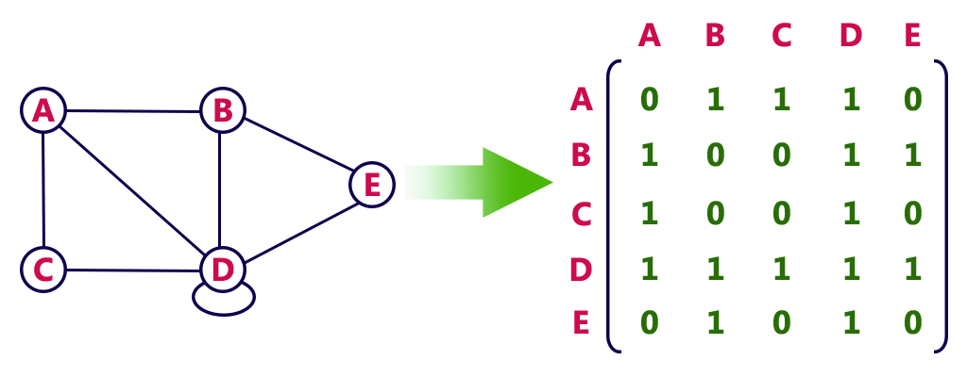
Graph Representations
Undirected graph representation.
Adjacency Matrix

Slide 13
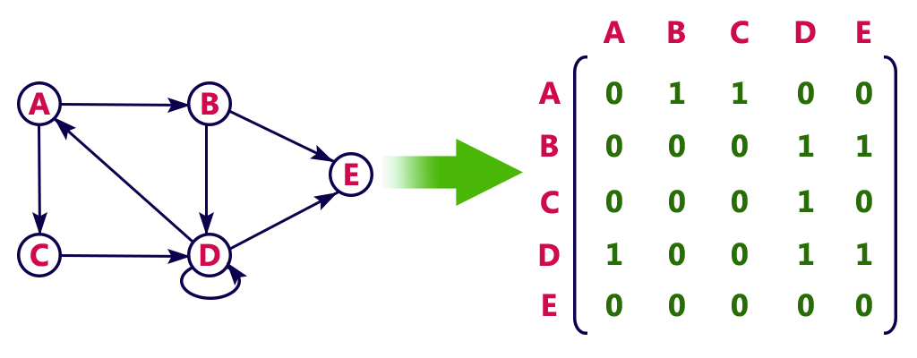
Graph Representations
Directed graph representation.
Adjacency Matrix

Slide 14
Graph Representations
Incidence Matrix
In this representation, graph can be represented using a matrix of size total number of vertices by total number of edges.
That means if a graph with 4 vertices and 6 edges can be represented using a matrix of 4X6 class.
In this matrix, rows represents vertices and columns represents edges.

Slide 15
Graph Representations
Incidence Matrix
This matrix is filled with either 0 or 1 or -1.
Here, 0 represents edge is not connected to vertex,
1 represents edge is connected as outgoing edge to vertex
-1 represents edge is connected as incoming edge to vertex.

Slide 16
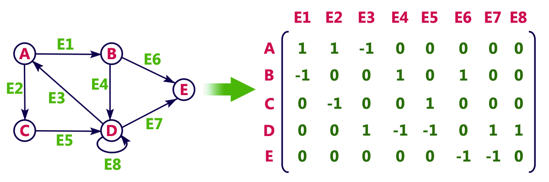
Graph Representations
Incidence Matrix

Slide 17
Graph Traversals
Graph traversal is technique used for searching a vertex in a graph.
The graph traversal is also used to decide the order of vertices to be visit in the search process.
A graph traversal finds the edges to be used in the search process without creating loops
There are two graph traversal techniques and they are as follows...
DFS (Depth First Search)
BFS (Breadth First Search)

Slide 18
Graph Traversals
DFS (Depth First Search)
Depth First Search (DFS) algorithm traverses a graph in a depthward motion and uses a stack to remember to get the next vertex to start a search, when a dead end occurs in any iteration.
Rule 1 − Visit the adjacent unvisited vertex. Mark it as visited. Display it. Push it in a stack.
Rule 2 − If no adjacent vertex is found, pop up a vertex from the stack. (It will pop up all the vertices from the stack, which do not have adjacent vertices.)
Rule 3 − Repeat Rule 1 and Rule 2 until the stack is empty.

Slide 19
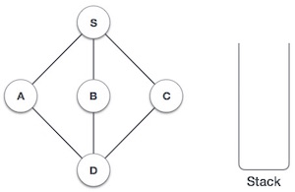
Graph Traversals
DFS (Depth First Search)
https://www.tutorialspoint.com/data_structures_algorithms/depth_first_traversal.htm

Slide 20
Graph Traversals
BFS (Breadth First Search)
Breadth First Search (BFS) algorithm traverses a graph in a breadthward motion and uses a queue to remember to get the next vertex to start a search, when a dead end occurs in any iteration.
Rule 1 − Visit the all adjacent unvisited vertex. Mark it as visited. Display it. Insert it in a queue.
Rule 2 − If no adjacent vertex is found, remove the first vertex from the queue.
Rule 3 − Repeat Rule 1 and Rule 2 until the queue is empty.

Slide 21
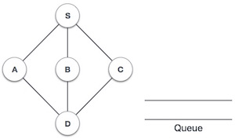
Graph Traversals
BFS (Breadth First Search)
https://www.tutorialspoint.com/data_structures_algorithms/breadth_first_traversal.htm

Slide 22
Graph Traversals
DFS (Depth First Search)
We use the following steps to implement DFS traversal...
Step 1: Define a Stack of size total number of vertices in the graph.
Step 2: Select any vertex as starting point for traversal. Visit that vertex and push it on to the Stack.
Step 3: Visit any one of the adjacent vertex of the vertex which is at top of the stack which is not visited and push it on to the stack.
Step 4: Repeat step 3 until there are no new vertex to be visit from the vertex on top of the stack.
Step 5: When there is no new vertex to be visit then use back tracking and pop one vertex from the stack.
Step 6: Repeat steps 3, 4 and 5 until stack becomes Empty.
Step 7: When stack becomes Empty, then produce final spanning tree by removing unused edges from the graph

Slide 23
Graph Traversals
DFS (Depth First Search)
http://btechsmartclass.com/DS/U3_T11.html

Slide 24
Graph Traversals
BFS (Breadth First Search)
We use the following steps to implement BFS traversal...
Step 1: Define a Queue of size total number of vertices in the graph.
Step 2: Select any vertex as starting point for traversal. Visit that vertex and insert it into the Queue.
Step 3: Visit all the adjacent vertices of the vertex which is at front of the Queue which is not visited and insert them into the Queue.
Step 4: When there is no new vertex to be visit from the vertex at front of the Queue then delete that vertex from the Queue.
Step 5: Repeat step 3 and 4 until queue becomes empty.
Step 6: When queue becomes Empty, then produce final spanning tree by removing unused edges from the graph

Slide 25
Graph Traversals
BFS (Breadth First Search)
http://btechsmartclass.com/DS/U3_T11.html

